Slide 1


Machine-Learning-Enabled Design for Molten Salt Reactors
Mehmet Turkmen, Kathryn D. Huff
Big Data for NPPs Workshop, The Ohio State University Columbus, OH - Dec. 10-11, 2019
Nuclear, Plasma and Radiological Engineering, University of Illinois at Urbana-Champaign

Slide 2
Motivation/Aim for This Study
To determine an optimized core design of for Molten Salt Reactors.
To use a novel, robust, reliable, and accelerated method in the designing process.
To make the reactor more efficient, compact, and safe
Aim: To introduce an efficient, robust, and reliable design recommendation approach based on machine learning methods
This talk presents preliminary results using AI/ML to find the optimized reactor parameters rather than traditional optimization methods such genetic algorithms.

Slide 3
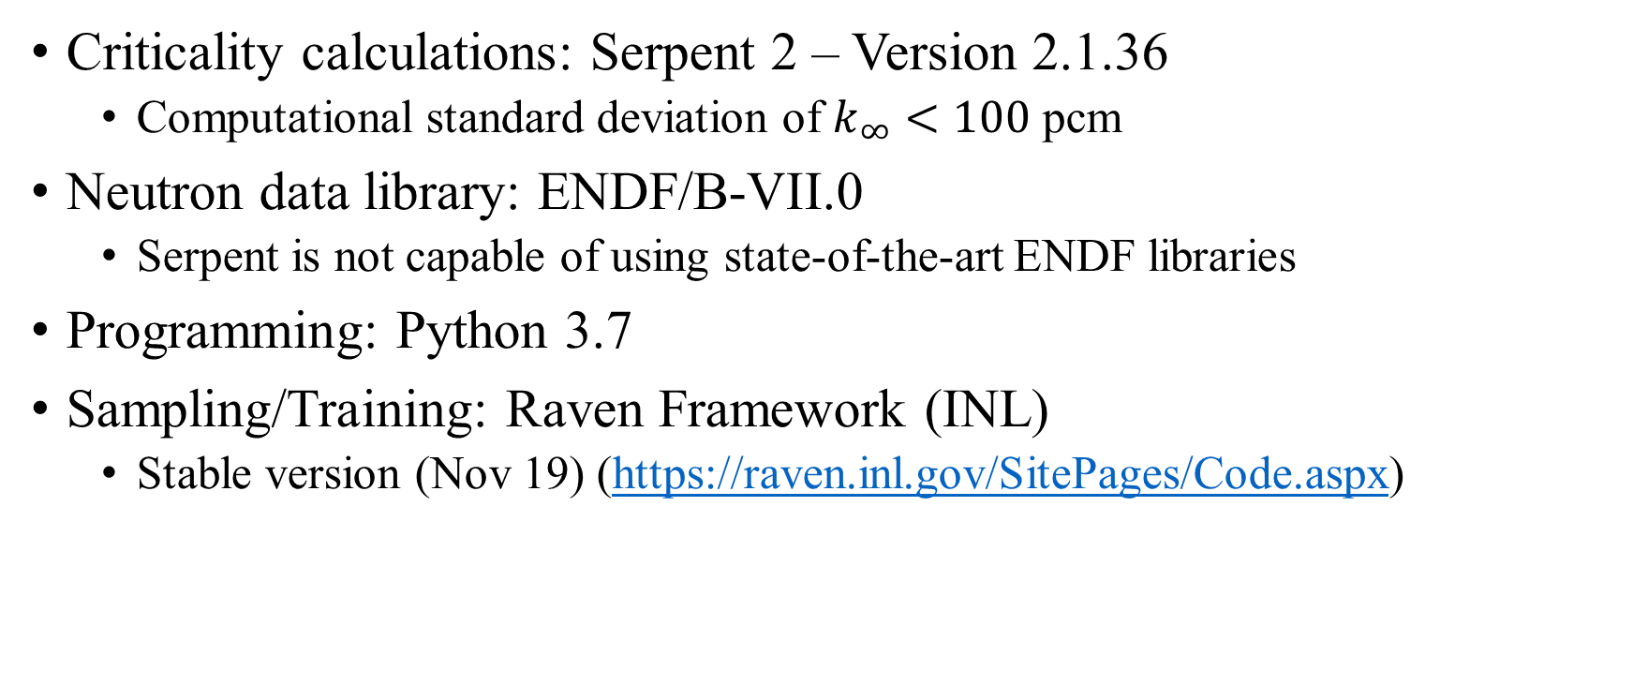
Programs/Codes Used
Criticality calculations: Serpent 2 – Version 2.1.36
Computational standard deviation of $k_{∞}<100$ pcm
Neutron data library: ENDF/B-VII.0
Serpent is not capable of using state-of-the-art ENDF libraries
Programming: Python 3.7
Sampling/Training: Raven Framework (INL)
Stable version (Nov 19) (https://raven.inl.gov/SitePages/Code.aspx)

Slide 4
Methods Used
Reactor model: Monte Carlo Technique (Serpent 2)
Target reactor design: Molten Salt Reactor
Sampling methods: Grid Sampling Approach
Training methods: ROMs
sci-kit learn
Neural Network
Decision Tree
K-Nearest Neighbors
Classification: Data Mining
Ensemble
Cluster
Method validation: single fuel channel with unit cell approximation

Slide 5
Method Validation
Pitch (p)
R_{f}
Single fuel channel using unit cell approximation
For square lattice cell geometry, 8 independent variables are under investigation for optimization.
Features:
Fuel type
Salt type, density and flow rate
Enrichment (ε)
Pitch (p) and channel radius (R_{f})
Moderator to fuel ratio
Channel length
q_{channel} (or in terms of T_{in} and T_{out})
Fuel Salt
T_{out}
Moderator
Length (L)
q_{channel}
v_{salt}
T_{in}

Slide 6
Input/Target Parameters Selected
Inputs:
Fuel types: U, U-Th, U-Pu
- Th as Th-232
- Pu as weapons-grade Pu
Salt types: LiF-BeF2, NaF-BeF2, NaCl
(i) LiF+BeF2 (72/16 mole %)+HM (12 mole %) - MSFR/Mosart/Flibe
rho(T)=3.628-6.6e-4*T(ºC)¹ for U-Th
(ii) NaF+BeF2 (76/12 mole %)+HM (12 mole %) - ThorCon
rho(T)=5.52-1.964e-3*T(ºC)² for U
(iii)NaCl (60 mole %)+HM (40 mole %) - Terrapower/Elysium/Moltex
rho(T)=4.29-1.59e-3*T(ºC)² for U
¹ Ref. Jerden, J., 2019. Molten Salt Thermophysical Properties Database Development: 2019 Update. Chemical and Fuel Cycle Technologies Division, ANL/CFCT-19/6
² Ref. Janz, G.J., 1988. Thermodynamic and Transport Properties for Molten Salts: Correlation Equations for Critically Evaluated Density, Surface Tension, Electrical Conductance, and Viscosity Data. ThermoJournal of Physical and Chemical Reference Data 17 (2) 1–309.

Slide 7
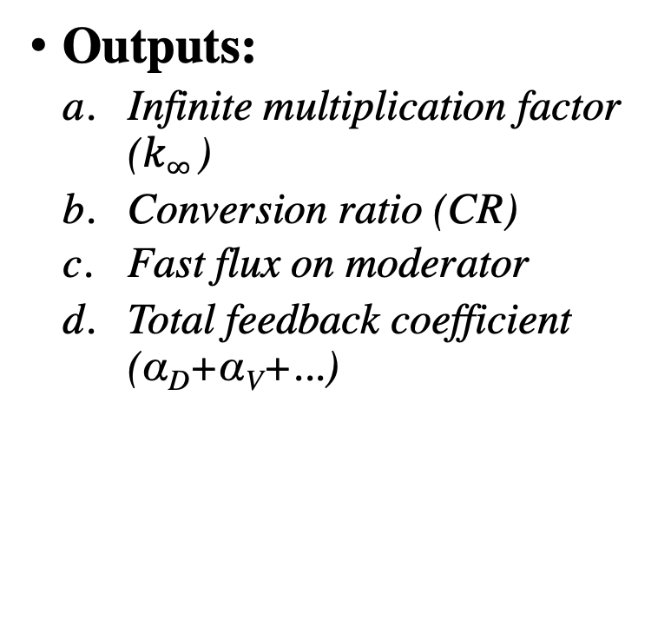
Input/Target Parameters Selected
Inputs:
²³⁵U fissile content (ε): 1 to 20 wt. % in HM
U content: 10 to 90 wt. % in HM
- 100 wt. % for U type
Pitch (p): 1 to 16 cm
- based on MSRE design
V_{moder}/V_{salt}: 0.274 to 10.46
- minimum value: 0.274 for p=D_{f}
- maximum value: 10.46 for p=3D_{f}
T_{fuel-average}: 900 to 1200 K
Outputs:
Infinite multiplication factor ($k∞$)
Conversion ratio (CR)
Fast flux on moderator
Total feedback coefficient (α_{D}+α_{V}+...)

Slide 8
Assumptions/Approximations/Simplifications
T_{fuel-aver} instead of q'_{channel} over a fuel channel length of 1m
Only neutronic calculations are under consideration
Thermal-hydraulics effects are ignored
Stationary fuel salt
Base-line temperature 900 K for feedback calculations
Temperature is the main driver for fuel salt density and Doppler feedback
Calculations just for initial fuel loading

Slide 9
Computational Flowchart
Sampling
Training
Agglomerative, K-Means etc.
Code Interface + Serpent2
External Physical
Model
Data Mining
(Clustering)
Raven Framework
Data Structures
Post-processing
HDF5, Print, Plot,...
Runs
Output:
k∞, CR,
φ_{fast}(graph), α_{feedback}
Reduced Order Models
(Regressors)
Samplers
Grid method
Distribution
Input:
Fuel, Salt, ²³⁵U wt%, U wt%, p, T_{fuel-ave}, V_{moder}/V_{salt}
SciKitLearn etc.

Slide 10
Grid Sampling Approach
The simplest exploration approach to explore an uncertain domain
Construct an N-dimensional grid where each dimension is represented by one uncertain variable
Equal distances
Performs the sampling at each node of the grid
Total number of samples: 31500
Variable | Fuel Type | Salt Type | ²³⁵U Content | U content | Pitch | V_{moder}/V_{salt} | T_{fuel-average}
Distribution | Discrete | Discrete | Continuous | Continuous | Continuous | Continuous | Continuous
Lower/Upper Values | U, U-Th, U-Pu | LiF-BeF2, NaF-BeF2, NaCl | 1-20 wt.% | 10-90 wt.% | 1-16 cm | 0.274-10.46 | 900-1200
Step Sizes | 3 | 3 | 7 | 5 | 5 | 5 | 4

Slide 11
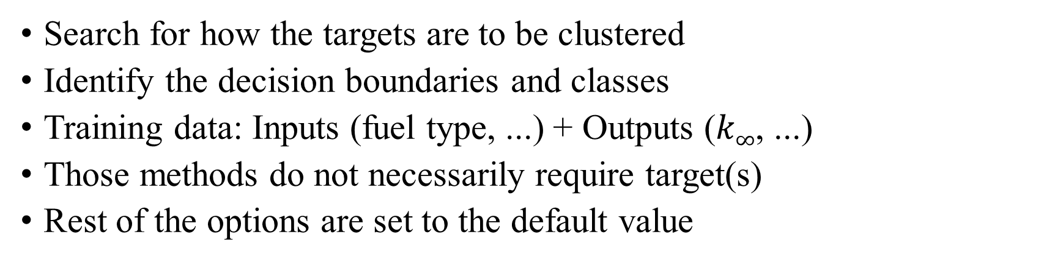
Data Mining
Options | KMeans | AgglomerativeClustering | DBScan
Classification | cluster | cluster | cluster
Solver | k-means++ | ward | eps=0.2
# of Clusters | 8 | 8 | min_samples=20
Metric |  | euclidean | euclidean
Search for how the targets are to be clustered
Identify the decision boundaries and classes
Training data: Inputs (fuel type, ...) + Outputs ($k∞$, ...)
Those methods do not necessarily require target(s)
Rest of the options are set to the default value

Slide 12
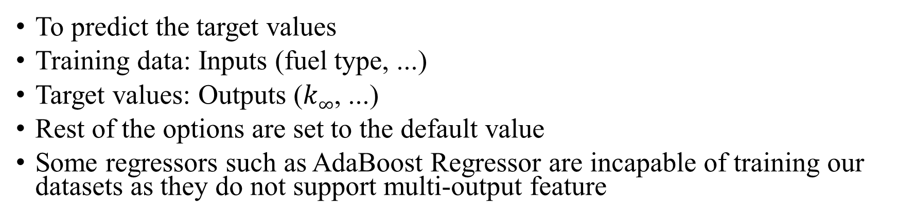
Reduced Order Methods
Methods | Class | Options
RandomForestRegressor | Ensemble | n_estimators=200
DecisionTreeRegressor | Decision Tree | -
KNeighborsRegressor | Neighbor Based | n_neighbors=20
MLPRegressor | Neural Network | max_iter=2000
To predict the target values
Training data: Inputs (fuel type, ...)
Target values: Outputs ($k∞$, ...)
Rest of the options are set to the default value
Some regressors such as AdaBoost Regressor are incapable of training our datasets as they do not support multi-output feature

Slide 13
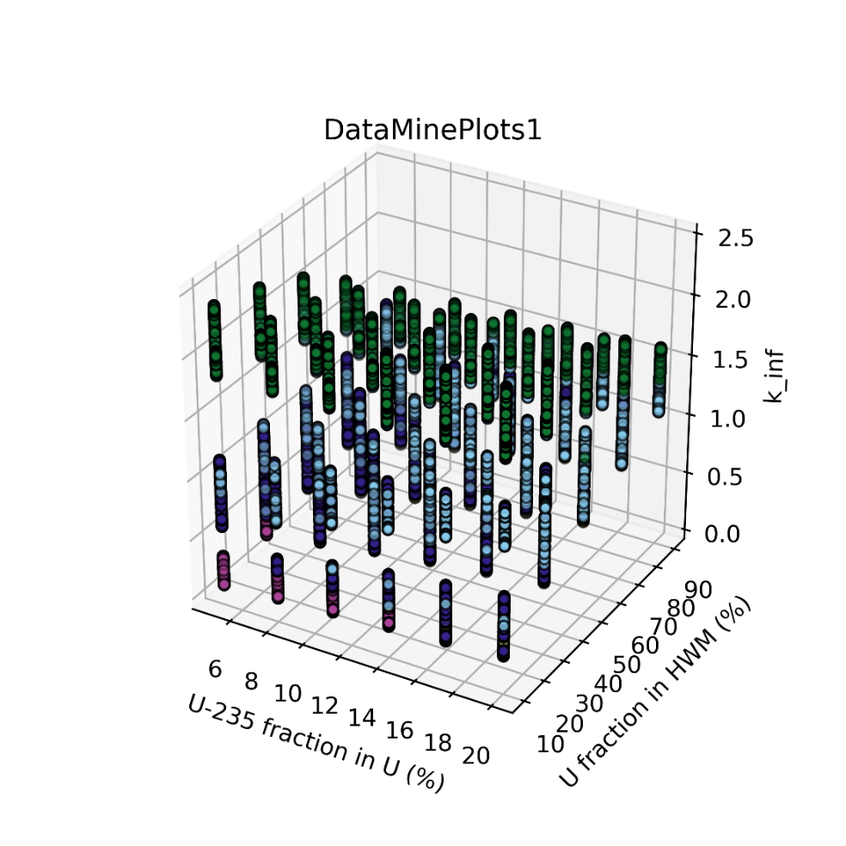
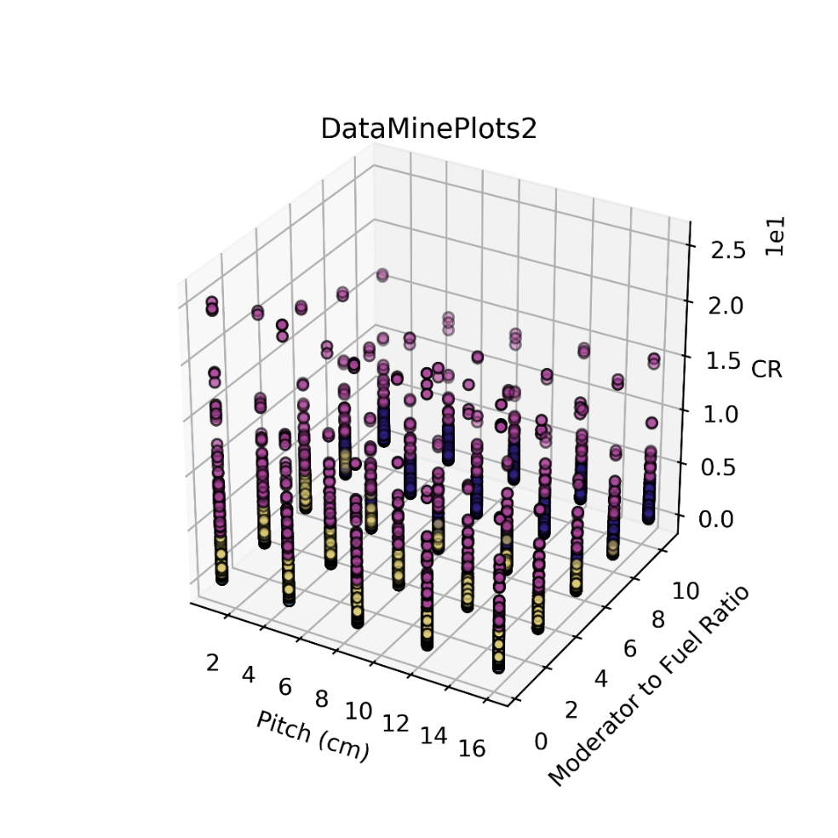
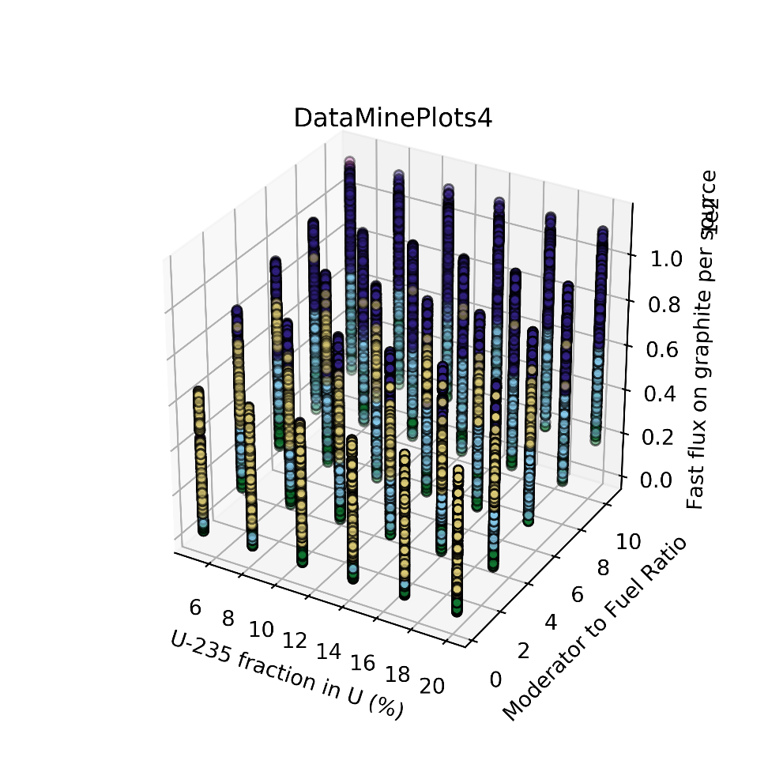
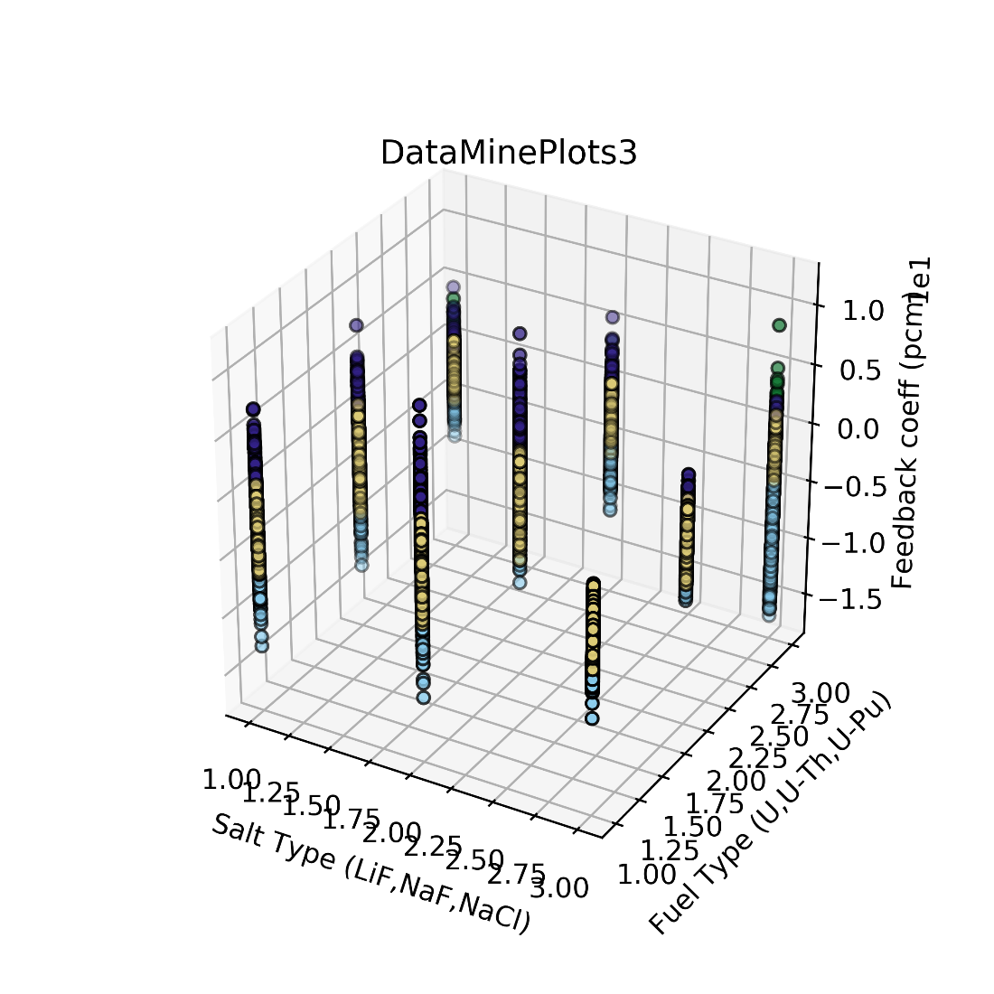
Results: Raw Data Distribution

Slide 14
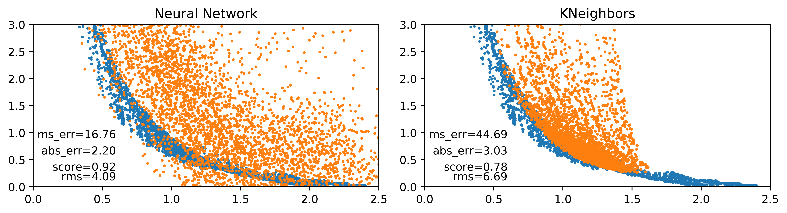
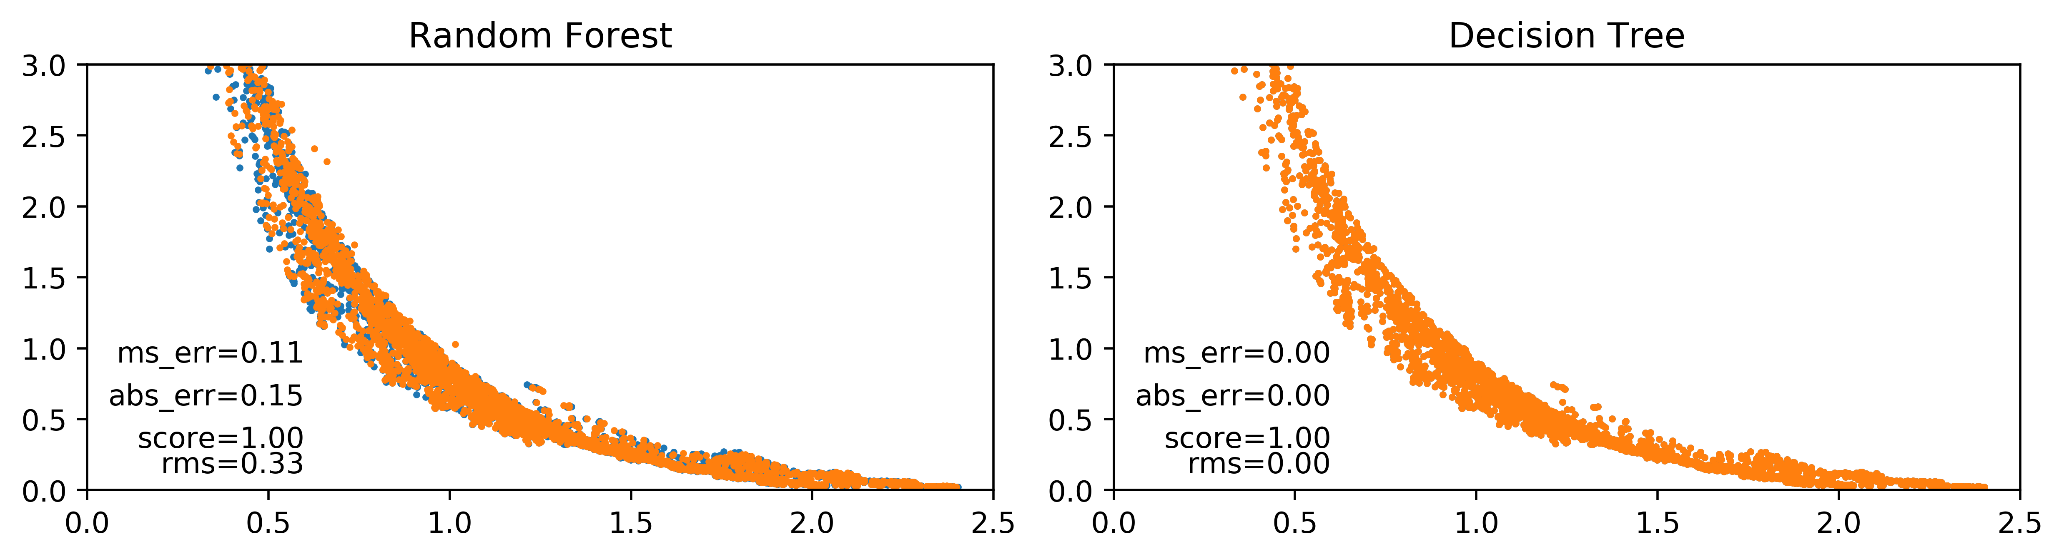
Results: Regressors
conv_ratio
conv_ratio
k_{inf}
k_{inf}
Random Forest and Decision Tree predictions (orange) agree well with the real values (blue)
Neural Network and K-Nearest Neighbors need improvement

Slide 15
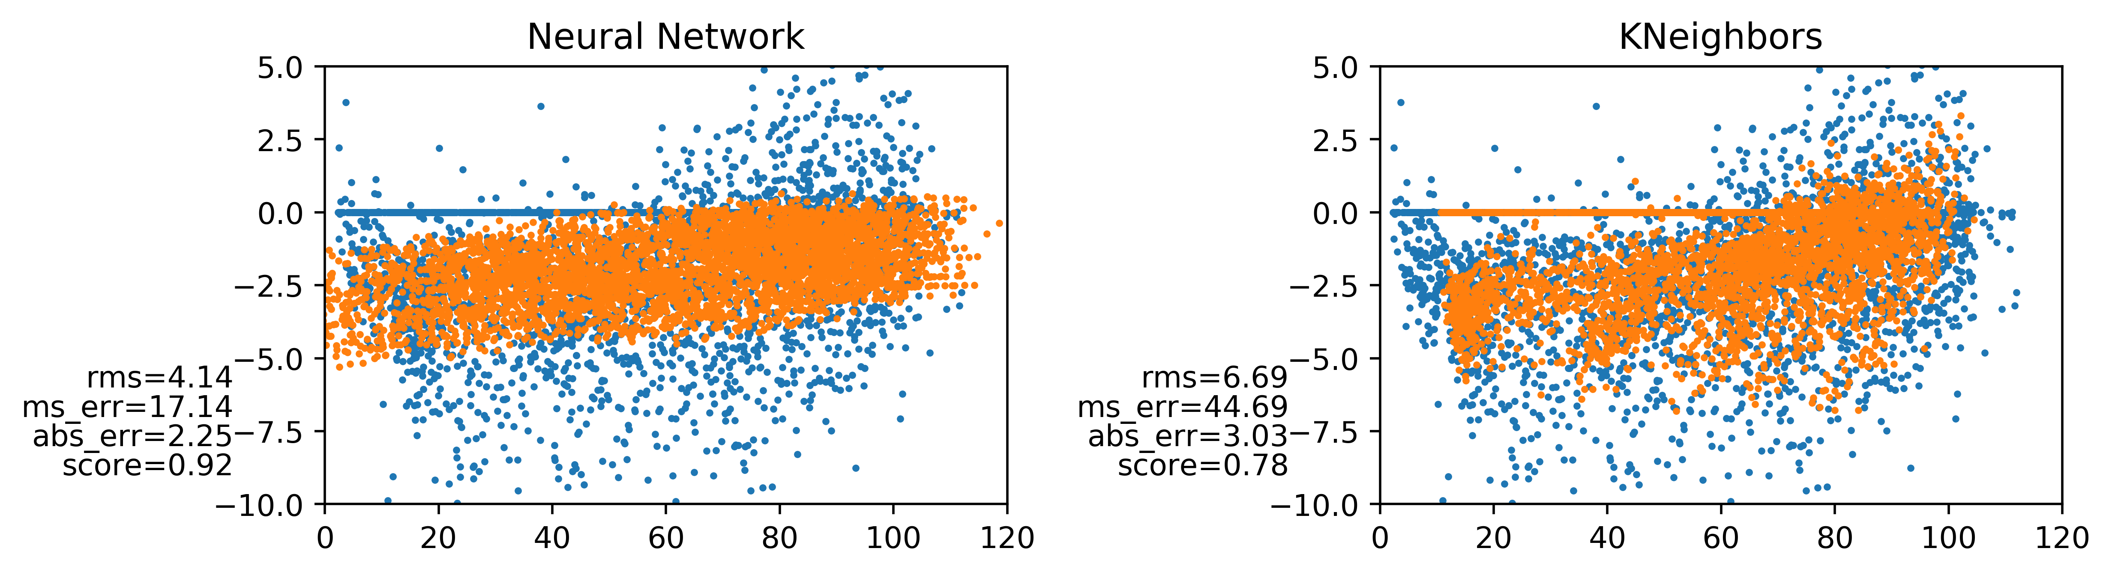
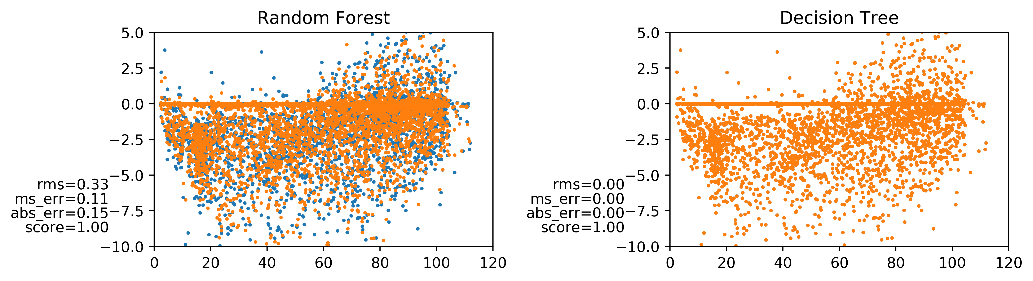
Results: Regressors
Feedback coef. (pcm)
Feedback coef. (pcm)
Fast flux per source
Fast flux per source

Slide 16
Results: Regressors
Random Forest and Decision Tree successfully predicted the target values of the test datasets. They have very high score (1) and root mean square (~0) values.
K-Nearest Neighbors and Neural Network totally fail in training the datasets provided.
Neural Network yields completely different results.
Neural Network is highly sensitive to its parameters. They need to be adjusted carefully according to the problem’s nature.

Slide 17
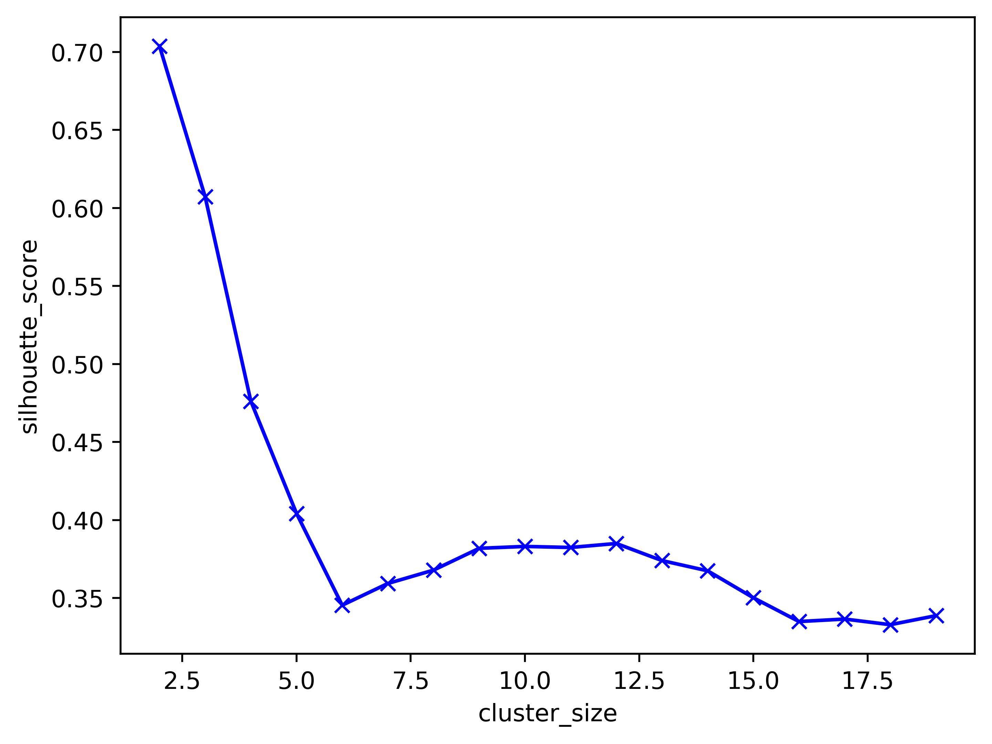
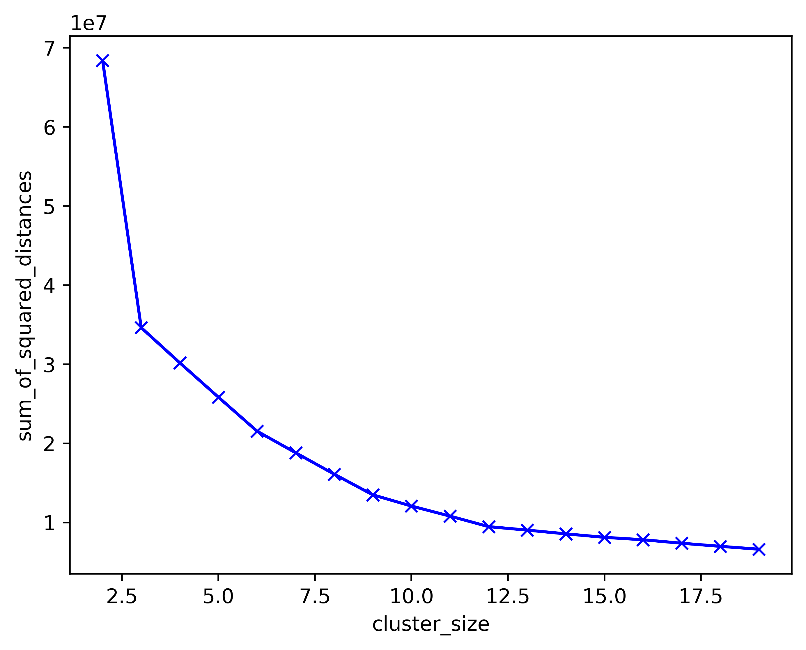
Results: Clusters- Optimal Cluster Size
KMeans & Agglomerative
Kmeans
Silhouette score and sum of squared distance calculation for cluster size determination
For clustering, optimum cluster size is 3-5. Set to 5 in calculations

Slide 18
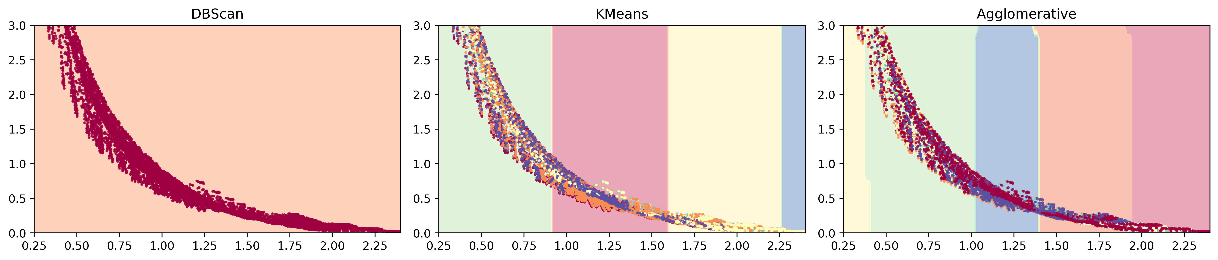
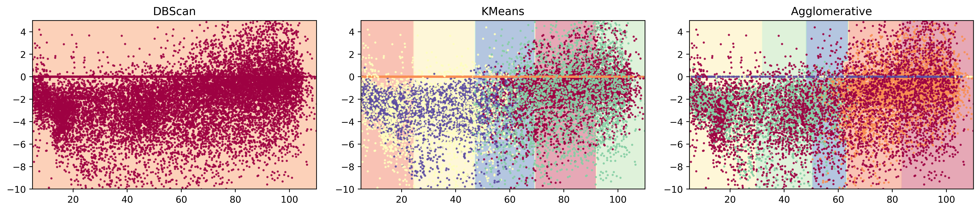
Results: Clusters
conv_ratio
k_{inf}
Feedback coef. (pcm)
Fast flux per source

Slide 19
Results: Clusters
Decision boundaries are not sufficiently clear
DBScan totally fails in clustering the datasets
Combine clustering method with regression method
Make cluster, select some classes and finally train the data over the selected classes (as a future work)

Slide 20
Conclusion
Based on the results of regression analyses, the suggested method gives promising results
The results show that the method works well for the fuel channel
It is possible to use this method to predict any target without running reactors physics code
Selection of the right regressors and classifiers is important
Categorical distribution in feature and multi-output in the target limit the use of different methods of Regressors and also Classifiers
Some cluster methods like DBScan do not resolve the search space
The database used in the optimization seems insufficient as the target space is not well-distributed, needs more data for better prediction
Some classification methods require class labels
Create some labels like ‘fast’ or ‘thermal’ reactor, ‘breeder’ or ‘burner’ (as a future work)

Slide 21
Future Works
Examine other regressors, clusters and classifiers
Use Monte Carlo based sampler
Expand the suggested method to fuel assembly and then to full-core
Couple to a thermal-hydraulics code (i.e. Moltres)
Perform analyses for equilibrium cycle with reprocessing option
Generate temperature-dependent ENDF/B-VIII.0 ACE libs for Serpent with NJOY21
Burnup and depletion analysis
Uncertainty analysis

Slide 22
Acknowledgements
This research is part of the Blue Waters sustained-petascale computing project, which is supported by the National Science Foundation (awards OCI-0725070 and ACI-1238993) and the state of Illinois. Blue Waters is a joint effort of the University of Illinois at Urbana-Champaign and its National Center for Supercomputing Applications.
The authors would also like to acknowledge financial support from the Scientific and Technological Research Council of Turkey (TUBITAK) BIDEB-2219 Postdoctoral Research Program.
Prof. Huff is supported by the Nuclear Regulatory Commission Faculty Development Program, the Blue Waters sustained-petascale computing project supported by the National Science Foundation (awards OCI-0725070 and ACI-1238993) and the state of Illinois, the NNSA Office of Defense Nuclear Nonproliferation R&D through the Consortium for Verification Technologies and the Consortium for Nonproliferation Enabling Capabilities (awards DE-NA0002576 and DE-NA0002534), the DOE ARPA-E MEITNER Program (award DE-AR0000983), and the International Institute for Carbon Neutral Energy Research (WPI-I2CNER), sponsored by the Japanese Ministry of Education, Culture, Sports, Science and Technology.

Slide 23

Thank you for your attention

